Slide 1
Operationalising sustainable tourism
Lecture 9

Slide 2
A caveat!
A systems thinking approach requires a business to consider itself within the entire system that it sits within.
A clear example of that would be understanding Scope 3 emissions
But for the purposes of what you could do as a business owner, this lecture looks at an individual tourism business,

Slide 3
Sustainability within the experience economy
Tourists themselves Can be part of the solution
Experiences become the currency for sustainability actioned by tourists
Sustainability becomes part of the value creation for tourists
Identifying (predictive) relationships between those markers
Co-CREATED EXPERIENCES using Service-DOMINANT LOGIC

Slide 4
1. Co-creation and service-dominant logic
Co-creation of value depends on having personalised experiences, engagement, and co-production
Service dominant logic (SD logic) considers value-in-use and co-creation of value

Slide 5
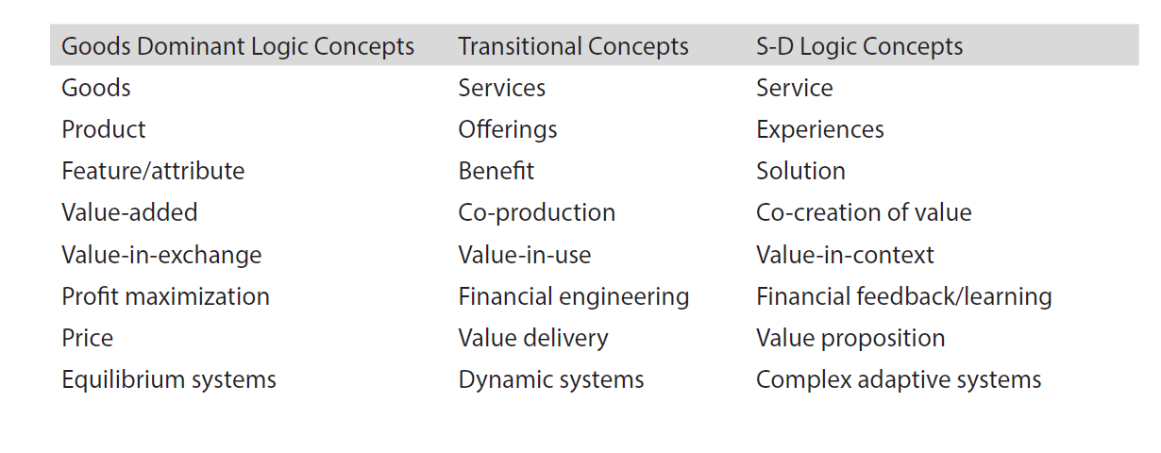

Slide 6
10 Foundational premises of SD Logic
The application of specialised skills and knowledge is the fundamental unit of exchange
Indirect exchange masks the fundamental basis of exchange.
Goods are a distribution mechanism for service provision.
Operant resources are the fundamental source of competitive advantage
All economies are service economies.
The customer is always a co-creator of value.
The enterprise cannot deliver value, only offer value propositions.
A service-centered view is inherently customer oriented and relational.
All social and economic actors are resource integrators.
Value is always uniquely and phenomenologically determined by the beneficiary.

Slide 7
Sustainability needs to be built into the business model
Actions that foster sustainability need to be part of the value-creation process for tourists
A Business Model Canvas can be used where sustainability becomes part of the value proposition and key activities, revenue streams, partners, resources, etc, flow on from the articulated value proposition

Slide 8
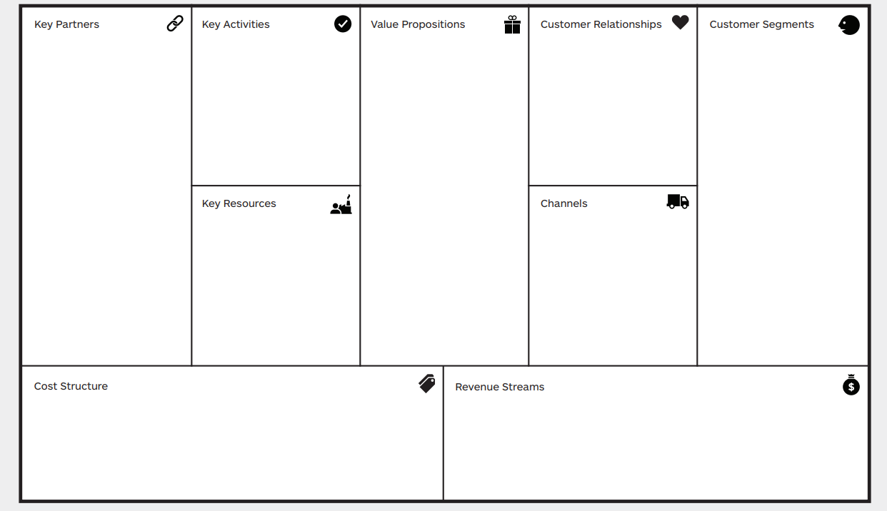
Business model canvas (from strategyzer.com)

Slide 9
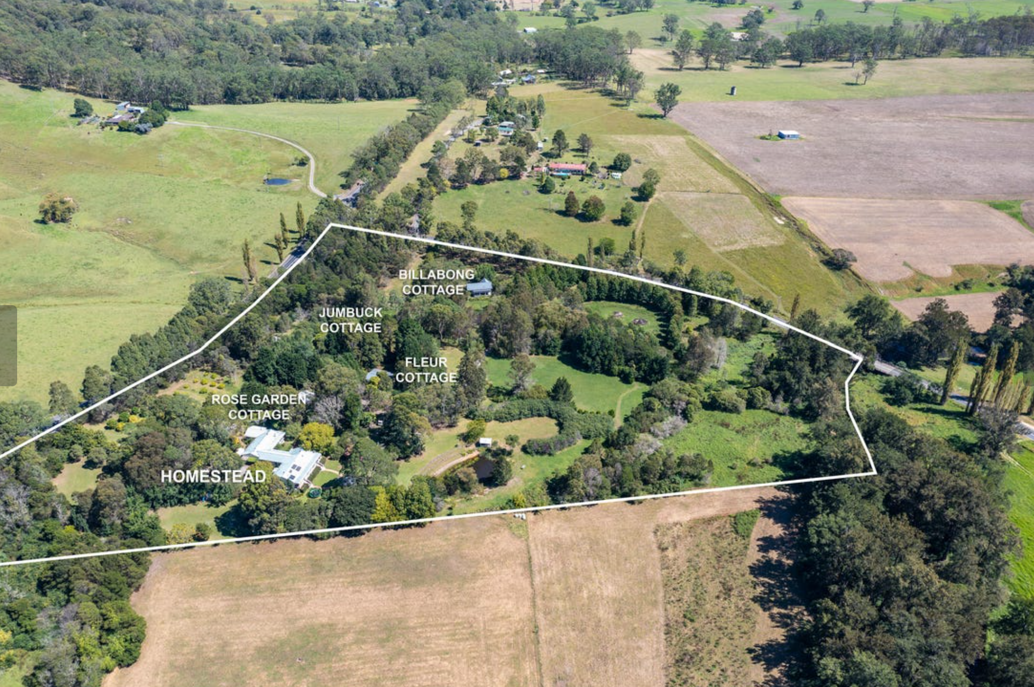
Case study of Crystal Creek Meadows

Slide 10

Details of the property
4 self-catered cottages on 16 acres of rural land
4.5 star ratings
150km south of Sydney, Australia
Not marketed as an eco-business
The business is certified as ecotourism and Climate Action
The business undertakes a number of eco-actions, around eco-efficiency, training, policies, infrastructure and community engagement
The strongest focus is on guest engagement

Slide 11
A signature strength approach
Guests who are happy with a positive, open outlook are more willing to engage with the “green” activities
Signature strengths are a positive psychology approach that build on the best in people and encourage personal wellbeing when using those strengths
Using signature strengths to frame green behaviours, those green behaviours become intrinsically rewarding

Slide 12
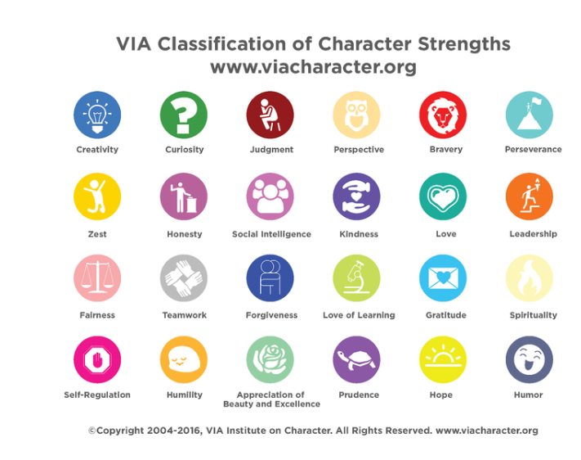
Some examples of signature strengths

Slide 13
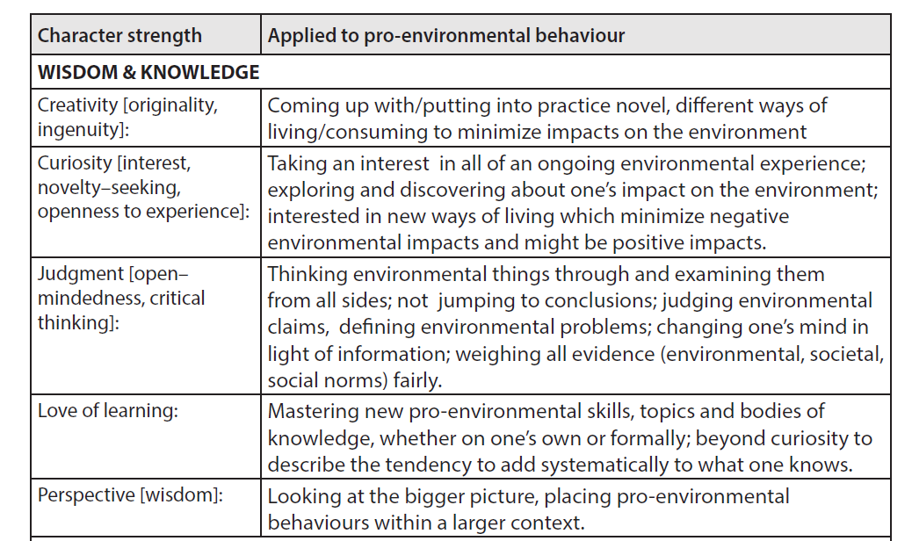
As applied to green behaviours

Slide 14
The process
Integrates sustainability in the value proposition by linking signature strengths to sustainability-oriented activities
Must be driven by the manager/owner of the property, who leads by example.
Relies on positive, wellbeing focused approaches, i.e. co-creating value with the guest, through a personalized engaging experience
Uses benchmarking, indicators and feedback to involve the guest in the process

Slide 15

The approach

Slide 16
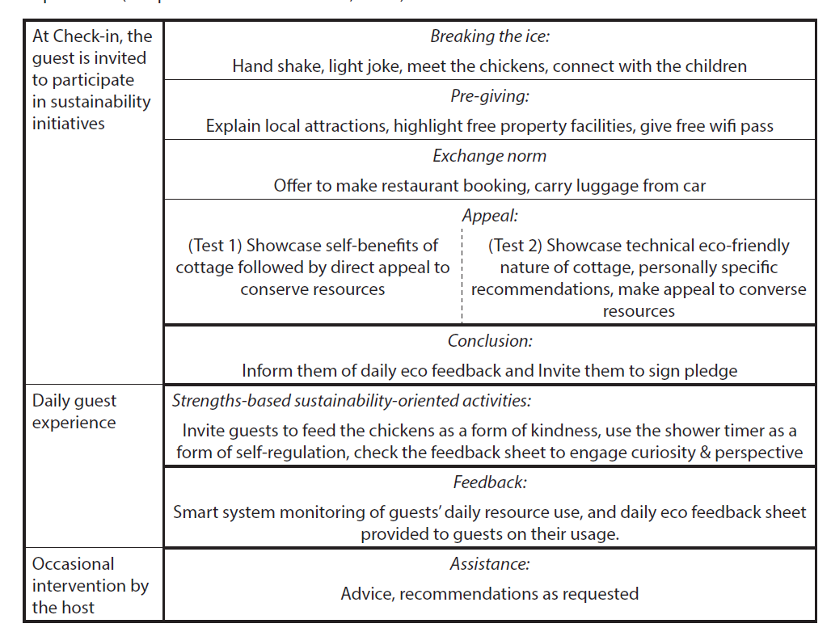
Introducing the concept to the guest
Taken from Warren et al., 2018). Sustainability-oriented service Innovation: a 14 year longitudinal study. Journal of Sustainable Tourism

Slide 17
Some activities matching
Kindness = saving food scraps for the chickens and feeding the chickens
Zest = borrowing bicycles with baskets and fresh produce for a picnic offsite
Self-regulation = water saving through timed showers
Citizenship = engagement with local wildlife charity

Slide 18
Some outcomes:
Monitored 1,000 guests for 17 months so covering all seasonal climatic variations, comparing those that got the My Green Butler treatment vs those that didn’t
My Green Butler guests used 38% less firewood, 33% less electricity, 21% less water and 20% less gas compared to other guests staying at the same accommodation in the same seasons.
They also tolerated a wider range of inside temperatures (+/– 1C ) and said they were more comfortable than other guests.
85% of My Green Butler guests said they choose to save resources, while only 59% of other guests said the same – but only those that got feedback did save
80% of guests engage with the process and found that it strongly added to the enjoyment of their sta

Slide 19
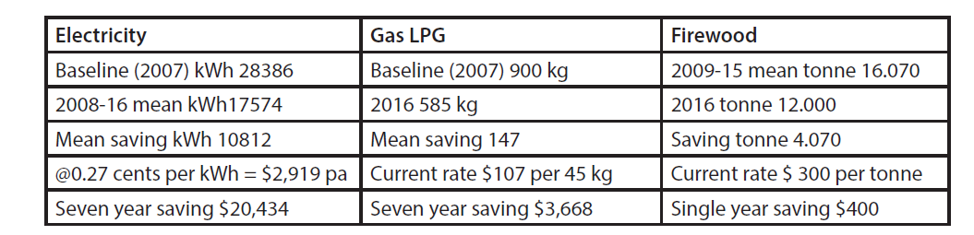
Is green is actually gold?

Slide 20

In conclusion
Embedding the guest in the sustainability efforts of a business can be very effective
Requires leadership by business, with skills and knowledge in that area
Should focus on intrinsically rewarding activities and wellbeing
Requires close monitoring through benchmarks, indicators, and communication
Requires embedding within the local economy
All of these combine various intervention
levels covered in Lecture 8.
Can you spot them?

Slide 21
Up next…
The future of sustainable tourism, changes and innovations

